Slide 1




Numbers from 1 to 2^{n} with for-loop

Slide 2
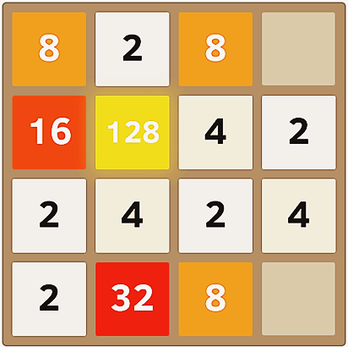
Numbers from 1 to 2^{n} with for-loop
Print the numbers from 1 to 2^{n}
Given n = 10: 1, 2, 4, 8, 16, 32, 64, 128, 256, 512, 1024
int num = 1;
for (var i = 0; i <= n; i++)
{
Console.WriteLine(num);
num = num * 2;
}
Testing the solution: https://judge.softuni.bg/Contests/Practice/Index/156#2

Slide 3

Numbers from 1 to 2^{n} with for-loop
Try it yourself

